Slide 1

CHAPTER 8
Phase
Diagrams

Slide 2
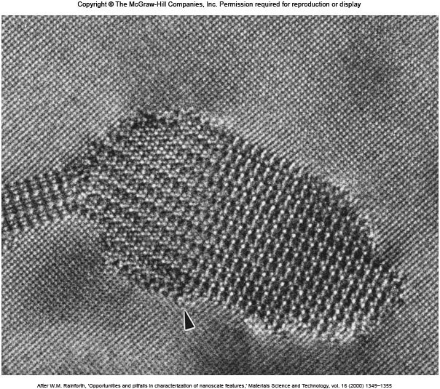
Al₂CuMg Precipitate in Al-Matrix

Slide 3
Introduction
Phase: A region in a material that differs in structure and/or composition from other regions.
Phase diagrams (equilibrium condition) :
Represents phases present in metal (materials) at different conditions (Temperature, pressure and composition).
Indicates solid solubility of one element in another.
Indicates temperature range under which solidification occurs.
Indicates temperature at which different phases start to melt.

Slide 4
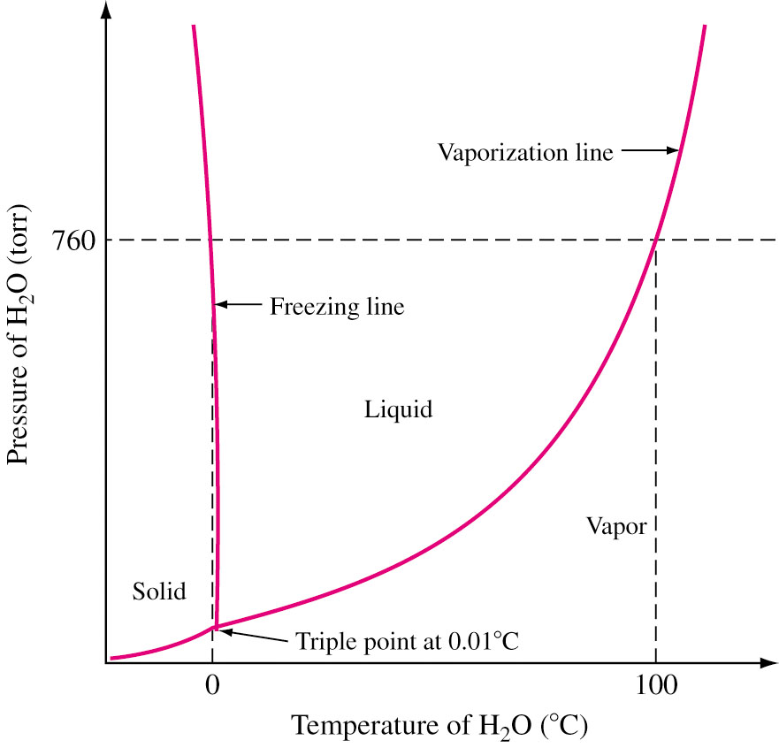
Phase Diagram of Pure Substances
Pure substance exist as solid, liquid and vapor, depending on the conditions of temperature and pressure.
Phases are separated by phase boundaries.
Different phases (S + L + V) coexist at triple point: 4.579 torr and 0.0098 °C.
Vaporization line: L + V.
Freezing line: S + L.
PT phase diagram of water.

Slide 5
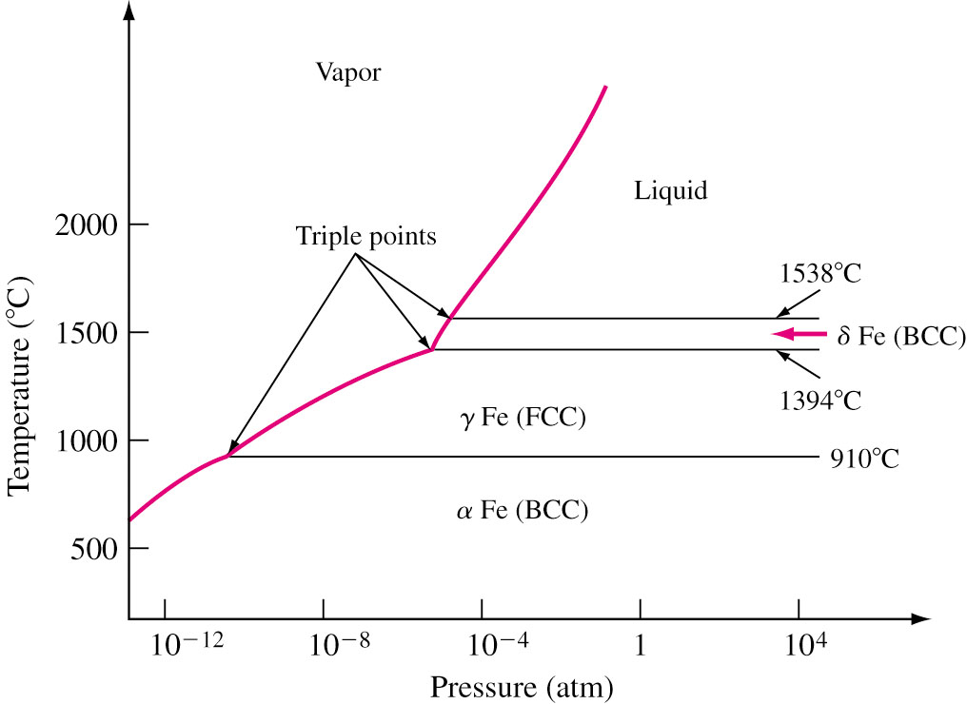
Phase Diagram of Pure Fe

Slide 6
Gibbs Phase Rule
F = CP + 2 − P − C(P − 1) = C − P + 2
P = number of phases that coexist in a system
C = Number of components
F = Degrees of freedom
P + F = C + 2
Degrees of freedom indicate number of variables that can be changed without changing number of phases.
For pure water, at triple point, 3 phases coexist. There is one component (water) in this system. Therefore 3 + F = 1 + 2 ⇒ F = 0 ⇒ Invariant point.
L-S freezing curve: 2 + F = 1 + 2 ⇒ F = 1 ⇒ P or T.
Single phase: 1 + F = 1 + 2 ⇒ F = 2 ⇒ P and T.
Pressure is always kept constant (In general):
P + F = C + 1
不變點

Slide 7
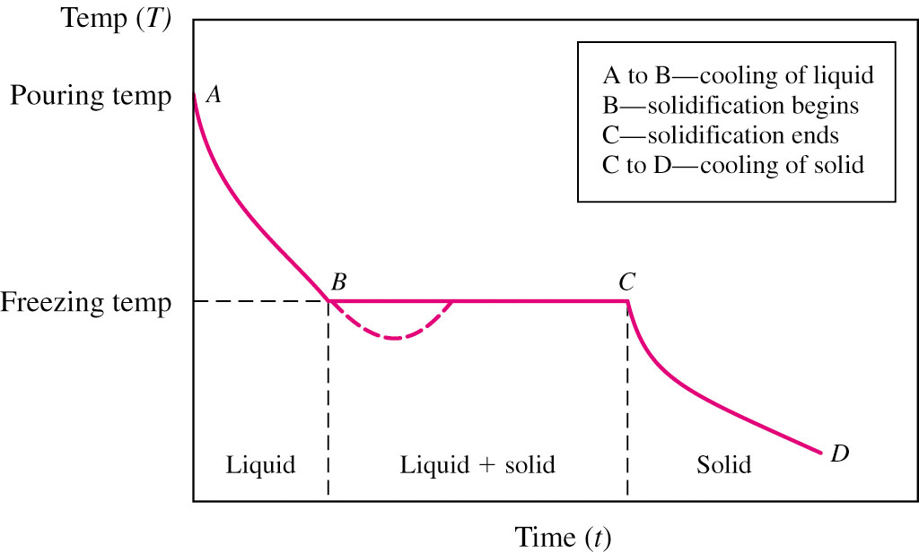
Cooling Curves
Plateau
Undercooling
Used to determine phase transition temperature. Temperature and time data of cooling molten metal is recorded and plotted.
Thermal arrest: heat lost = heat supplied by solidifying metal.
Alloys solidify over a range of temperature.
熱穩定

Slide 8
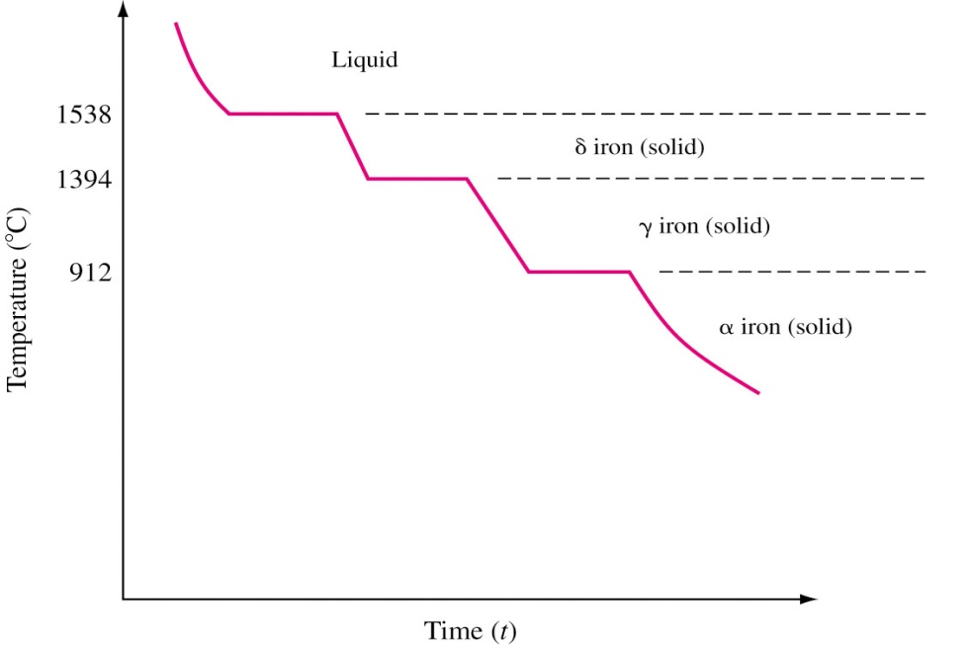
Cooling Curve for Pure Iron (1 atm)

Slide 9
Binary Isomorphous Alloy Systems
二元同型合金系
Mixture of
two systems
Two component
system
Binary alloy
Components: Elements or Compounds.
Isomorphous system: Two elements completely soluble in each other in liquid and solid state.
In order for the two elements to have complete solid solubility in each other, they usually satisfy one or more Hume-Rothery rules:
The size difference of the atoms < 15%.
No appreciable difference in the electronegativities.
The crystal structure must be the same.
The same valence.

Slide 10
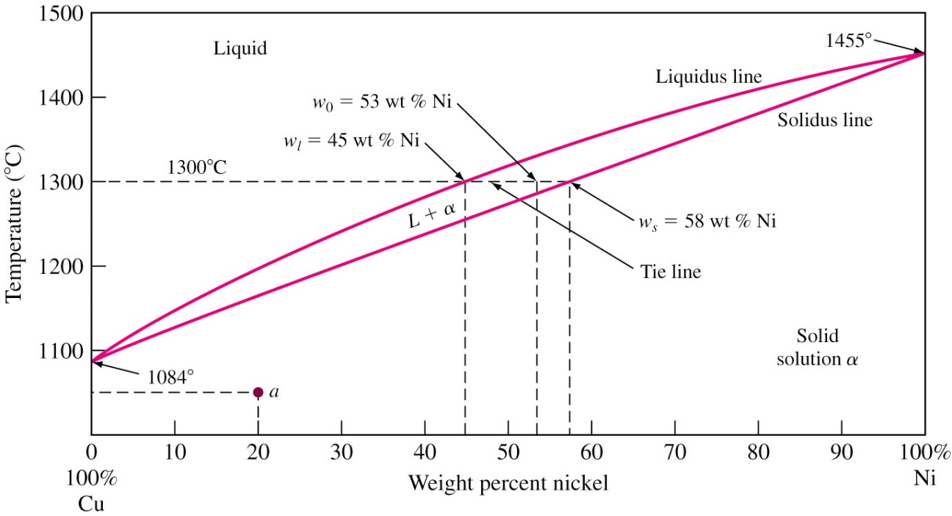
Cu-Ni Phase Diagram
Liquidus vs. Solidus.
Melting point of pure components: F = 1 − 2 + 1 = 0. Invariant point: change in temperature will change to L or S.

Slide 11
Cu-Ni Phase Diagram (Cont..)
Single phase regions: F = 2 − 1 + 1 = 2. Maintain the single phase by varying the temperature or composition independently.
Two phase regions: F = 2 − 2 + 1 = 1. If the temperature is changed, the phase composition will also change. And vice versa.
Point a (1050 °C, 20% Ni): Solid solution α microstructure appears the same as that of a pure metal. However, it has higher strength and resistivity than pure cooper.
Composition at liquid and solid phases at any temperature can be determined by drawing a tie line.
1300 °C, 53%Ni-47%Cu: L (45% Ni) + S (58% Ni)
連結線

Slide 12
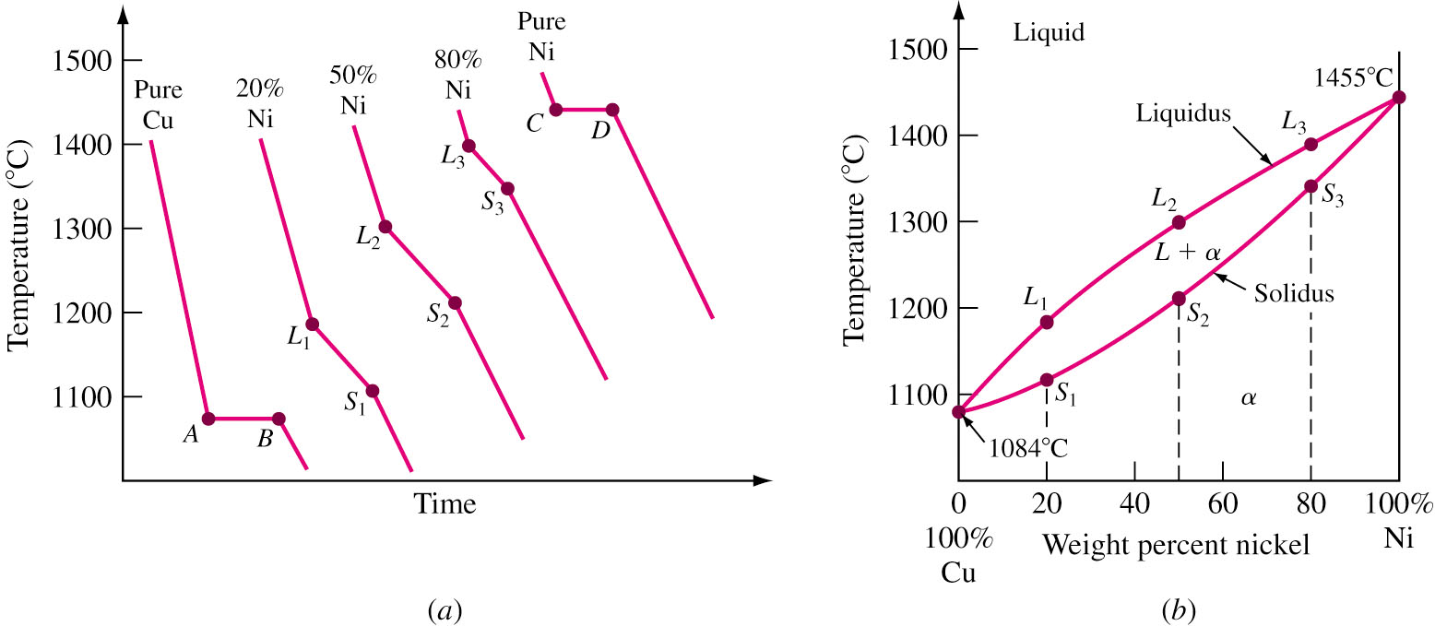
Phase Diagram from Cooling Curves
Series of cooling curves at different metal composition are first constructed.
Points of change of slope of cooling curves (thermal arrests) are noted and phase diagram is constructed.
More the number of cooling curves, more accurate is the phase diagram.
Freezing temperature
Freezing temperature
Figure 8.4

Slide 13
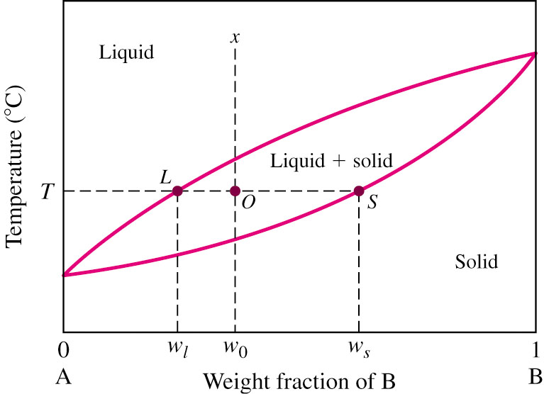
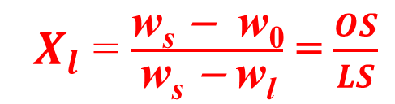
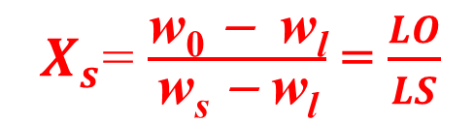
The Lever Rule 槓桿法則
The Lever Rule gives the weight % (weight fraction × 100%) of phases in any two phase regions.
Alloy w₀ (B) at T: X_{l} + X_{s} = 1 w₀ = X_{l} w_{l} + X_{s} w_{s}
w₀ = X_{l} w_{l} + (1 − X_{l}) w_{s} X_{l} (w_{s} − w_{l}) = w_{s} − w₀
⇒
w₀ = (1 − X_{s} ) w_{l} + X_{s} w_{s} X_{s} (w_{s} − w_{l}) = w₀ − w_{l} ⇒
w_{s} – w₁
${ X}_{l}$ = $\frac{\text{w}\text{s}\text{ − }\text{w}\text{0}}{\text{w}\text{s} \text{− }\text{w}\text{l}}$ = $\frac{OS}{LS}$
ws – w1
${ X}_{s}$= $\frac{\text{w}\text{0}\text{ − }\text{w}\text{l}}{\text{w}\text{s} \text{− }\text{w}\text{l}}$ = $\frac{LO}{LS}$

Slide 14
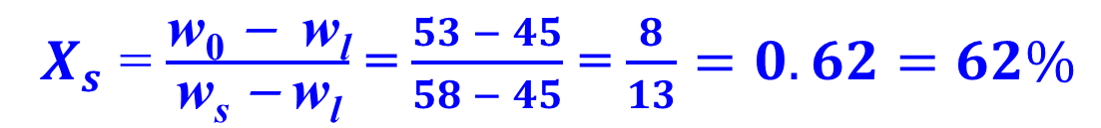
EP. 8.2 A copper-nickel alloy contains 47% Cu and 53% Ni and is at 1300 °C. (a) What is the weight percent of copper in the liquid and solid phases at this temperature? (b) What weight percent of this alloy is liquid, and what weight percent is solid?
(a)
w_{l} = 55% Cu w_{s} = 42% Cu (b)
${ X}_{l}$ = $\frac{\text{w}\text{s}\text{ − }\text{w}\text{0}}{\text{w}\text{s} \text{− }\text{w}\text{l}}$ = $\frac{58 − 53}{58 − 45}$ = $\frac{5}{13}=0.38=38\%$
${ X}_{s}$ = $\frac{\text{w}\text{0}\text{ − }\text{w}\text{l}}{\text{w}\text{s} \text{− }\text{w}\text{l}}$ = $\frac{53 − 45}{58 − 45}$ = $\frac{8}{13}=0.62=62\%$

Slide 15
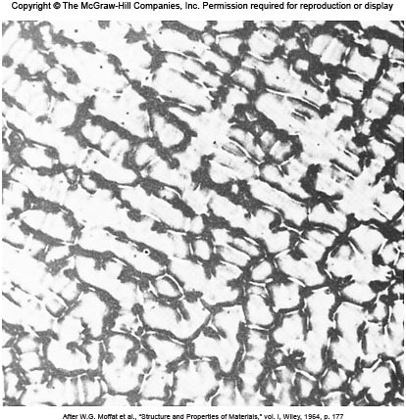
Coring Structure 內偏析
Phase Diagram: Very slow cooling (equilibrium).
In general: As-cast alloy gives rise to cored structure.
Cored structure: Inner grain regions of different chemical composition.
More Ni
Less Ni
Fig. 8.8 As-cast 70Cu-30Ni alloy

Slide 16
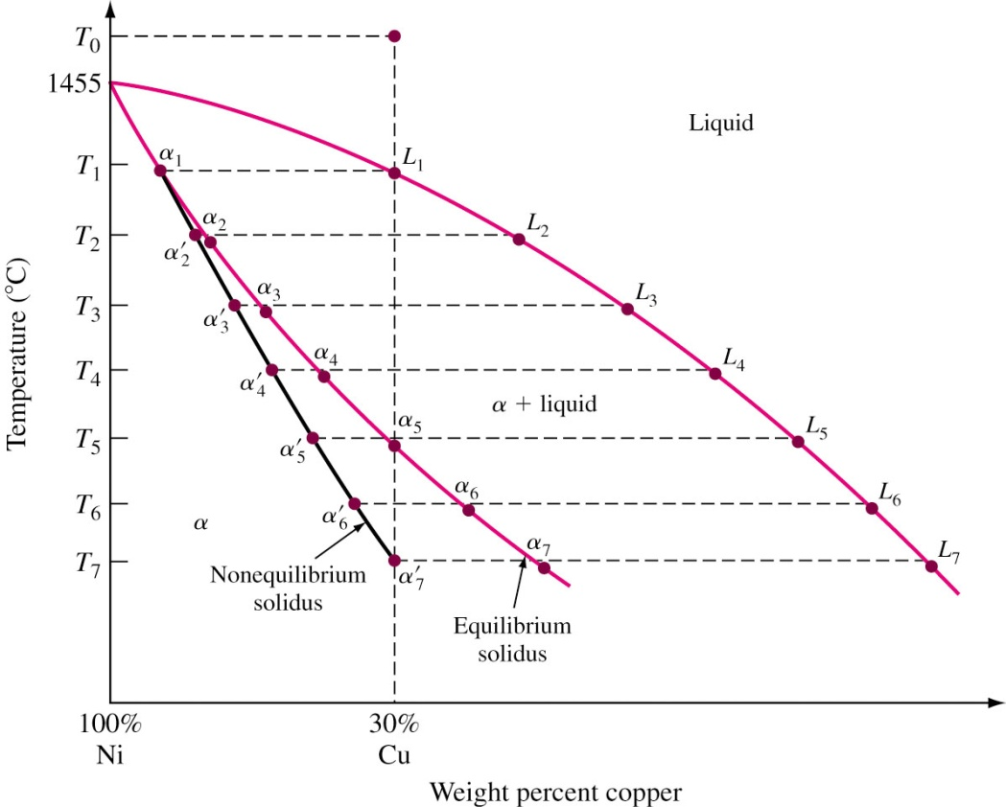
Non Equilibrium Solidification of Alloys
T₀ : L (30Cu) T₁ : L₁ (30Cu) + α₁ (5.3Cu)
T₂ : L₂ (43.2Cu) + α’₂ (8.9Cu) α₂ (10.5Cu)
T₃ : L₃ (54.7Cu) + α’₃ (13.2Cu) α₃ (17.4Cu)
T₄ : L₄ (64.2Cu) + α’₄ (17.1Cu)
α₄ (22.8Cu)
T₅ : L₅ (73.2Cu) + α’₅ (21.6Cu) α₅ (30.0Cu)
T₆ : L₆ (80.5Cu) + α’₆ (25.8Cu) α₆ (37.9Cu)
T₇ : L₇ (86.8Cu) + α’₇ (30.0Cu) α₇ (45.8Cu)
Rapid cooling (more liquid than equilibrium)
delays solidification.

Slide 17
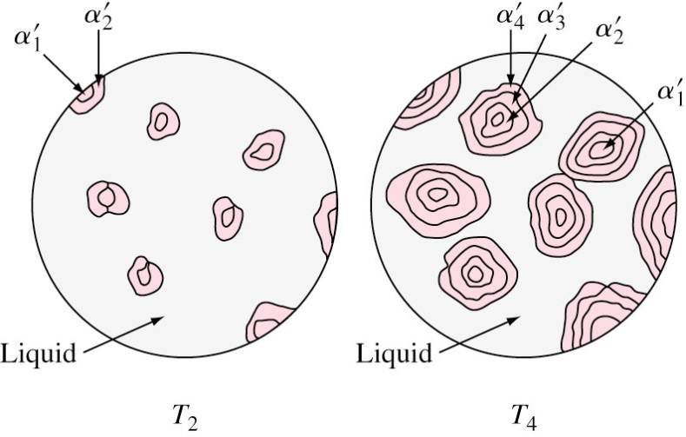
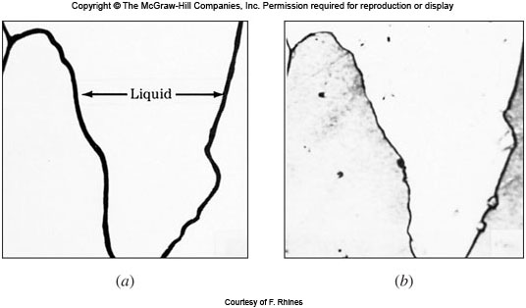
Coring Structure and Homogenization
The average concentration of the alloy follows α₁α’₂α’₃α’_{4…}α’₆α’_{7.}
Composition varying from α₁ to α₇ as the cored structure.
Homogenization: Cast ingots heated to elevated temperature to eliminate cored structure.
Temperature of homogeni-zation must be lower than lowest melting point of any of the alloy components.
Liquation in a 70Ni-30Cu alloy.

Slide 18
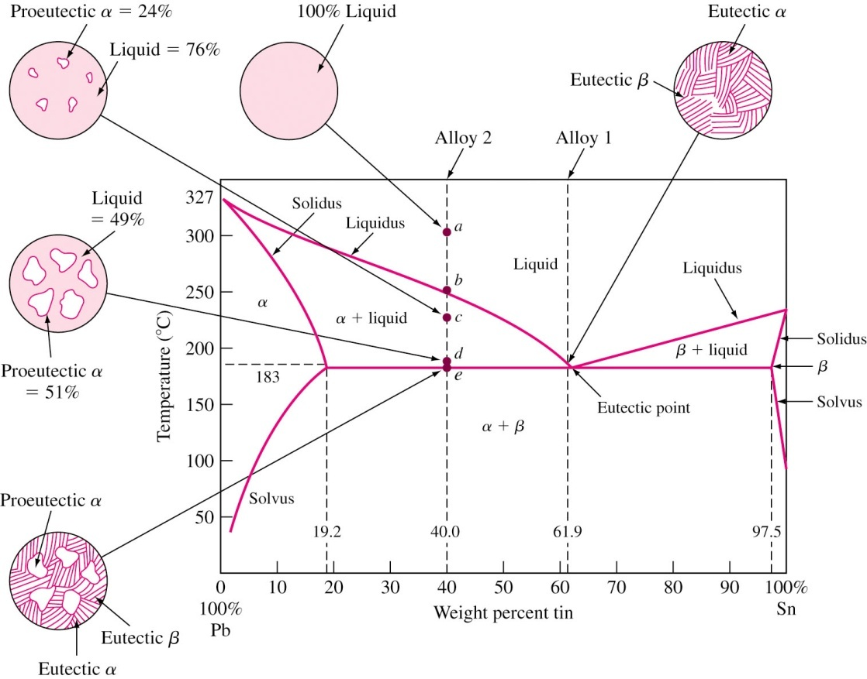
Pb-Sn Phase Diagram
終端固溶體
Terminal solid solution: α, β
共晶點
固溶線
固溶線

Slide 19
Binary Eutectic Alloy System
In some binary alloy systems, components have limited solid solubility.
Eutectic composition freezes at lower temperature than all other compositions.
This lowest temperature is called eutectic temperature. This eutectic reaction is an invariant reaction (F = 0). Three phases coexist and are in equilibrium.
Slow cooling of Pb-61.9Sn alloy, at 183 °C :
Below 183 °C: decreasing in solubility of solute in α and β. However, diffusion is slow and α and β distinguished at RT.
Eutectic temperature
Liquid
α solid solution + β solid solution
Cooling
183 °C
L (61.9% Sn)
α (19.2% Sn) + β (97.5% Sn)
Cooling

Slide 20
Slow Cooling of 40% Sn – 60% Pb alloy
Hypoeutectic vs. Hypereutectic
Liquid at 300 °C. 亞共晶vs.過共晶
At about 245 °C, first solid (α: 12% Sn) forms –Primary or Proeutectic solid. 前共晶固體
From 245 to 183 °C: α + L α: follows solidus and Sn varies from 12% to 19.2%; L: follows liquidus and Sn varies from 40% to 61.9%.
At 183 °C, remaining liquid solidifies. α + L → α + (α + β) α: 19.2% Sn; β: 97.5% Sn
L
α
Below 183 °C, follows solvus and lowers the solute content.

Slide 21
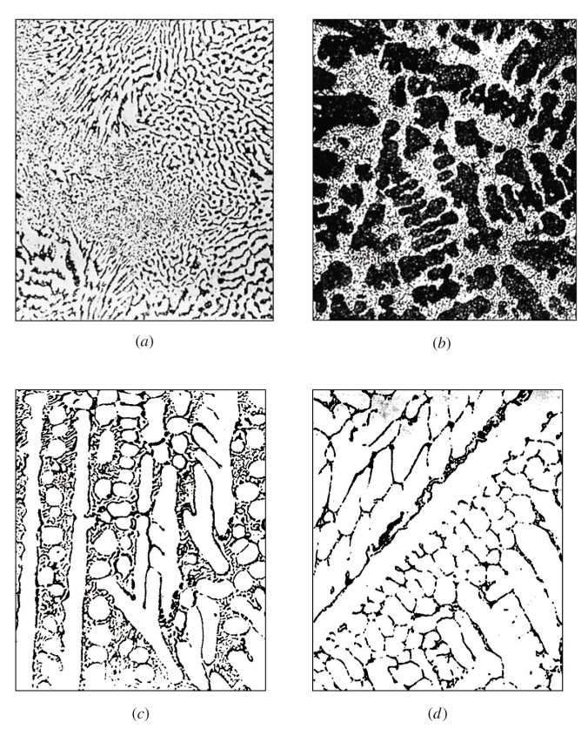
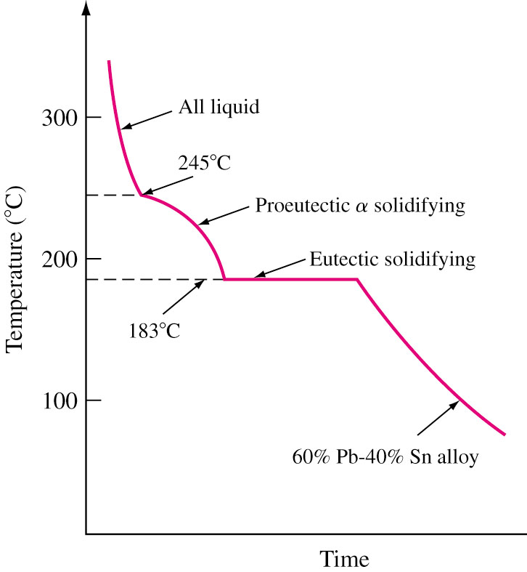
Microstructure and Cooling Curve
63Sn-37Pb
40Sn-60Pb
Fig. 8.14 Cooling curve for a 60Pb-40Sn alloy
70Sn-30Pb
90Sn-10Pb

Slide 22
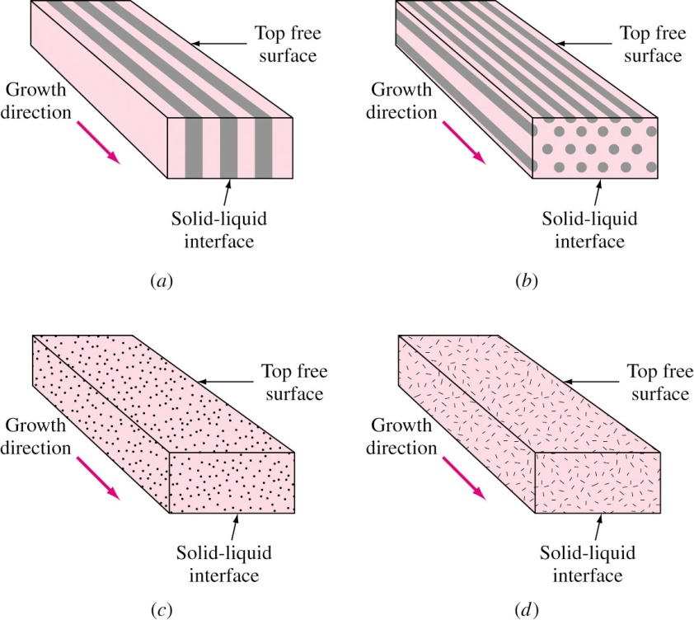
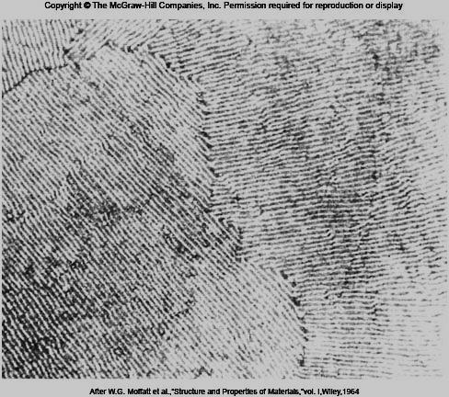
Various Eutectic Structures
Structure depends on factors like minimization of free energy at α/β interface.
Nucleate and grow man-ner or relative quantity of α/β affects structures.
lamellar
rodlike
globular
acicular
Lamellar eutectic structure of the Pb-Sn alloy.

Slide 23
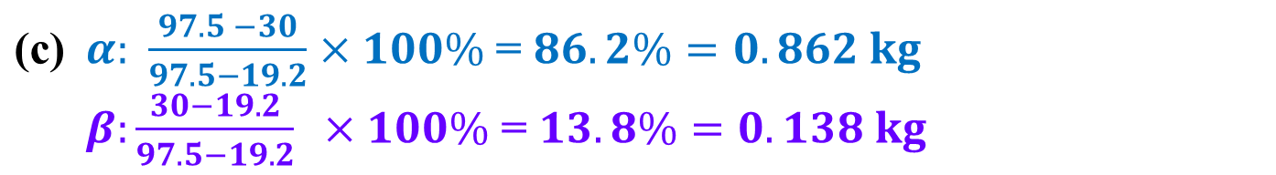
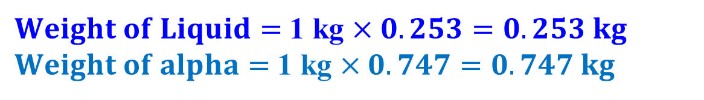
EP. 8.5 One kilogram of an alloy of 70 percent Pb and 30 percent Sn is slowly cooling from 300 °C. Calculate the following: (a) The wt% of the liquid and proeutectic alpha at 250 °C. (b) The wt% of the liquid and proeutectic alpha at 184 °C and the weight in kilograms of these phases. (c) The weight in kilograms of α and β formed at 182 °C .
$\text{(}\text{a}\text{)} L: \frac{30 −12}{40 −12}×100\%$= $64\% α: \frac{40 −30}{40 −12}×100\%$= $36\%$
$\text{(}\text{b}\text{)} L: \frac{30 −19.2}{61.9−19.2}×100\%$= $25.3\% α: \frac{61.9 −30}{61.9−19.2}×100\%$= $74.7\%$
$Weight of Liquid=$ 1 kg $×0.253=0.253 kg$ $Weight of alpha=$ 1 kg $×0.747=0.747 kg$
$\text{(}\text{c}\text{)} α: \frac{97.5 −30}{97.5−19.2}×100\%$ = $86.2\%=0.862 kg$ $$β:\frac{30−19.2}{97.5−19.2} ×100\%\text{ = }13.8\%=0.138 kg$$
23

Slide 24
Pb-Sn Phase Diagram

Slide 25
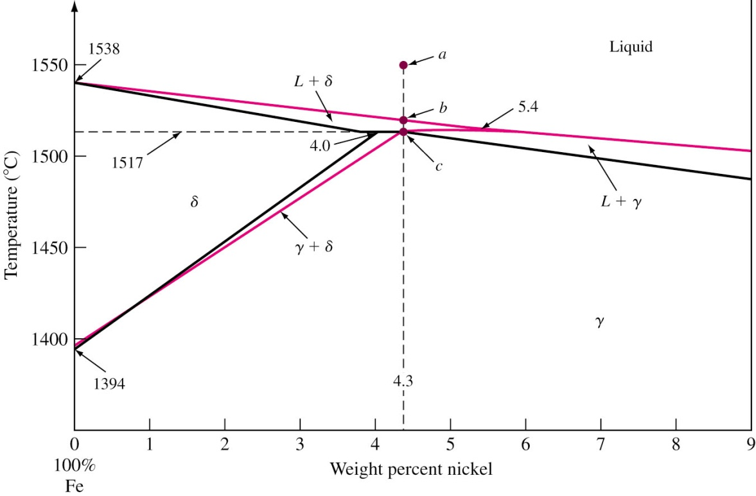
Binary Peritectic Alloy System
Peritectic reaction: Liquid phase reacts with a solid phase to form a new and different solid phase.
Liquid + α β
cooling
包晶反應
Peritectic reaction occurs when a slowly cooled alloy of Fe-4.3 wt% Ni passes through peritectic temperature of 1517 °C.
Peritectic point is invariant.
1517 °C
Liquid (5.4 wt% Ni) + δ (4.0 wt% Ni) γ (4.3 wt% Ni)
cooling

Slide 26
Cooling of Peritectic Alloy
Fe-4.3 wt% Ni
a 1550 °C: L (4.3Ni)
b 1525 °C: δ (3.0Ni) + L (4.3Ni) 1518 °C: δ (4.0Ni) + L (5.4Ni)
c 1517 °C: δ (4.0Ni) + L (5.4Ni) → γ (4.3Ni) 1516 °C: γ (4.3Ni)
Lever rule is used for two-phase regions.
< 4.0%Ni: L → L + δ → δ → δ + γ → γ
4.0-4.3%Ni: L → L + δ → δ + γ → γ
4.3%Ni: L → L + δ → γ
4.3-5.4%Ni: L → L + δ → L + γ → γ
> 5.4%Ni: L → L + γ → γ
L
δ
γ

Slide 27
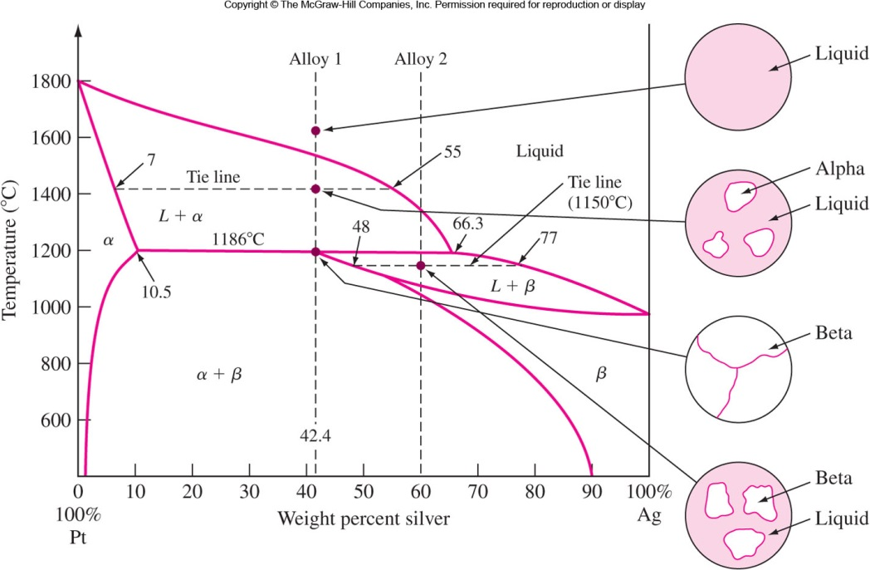
Peritectic Pt-Ag Alloy System
1400 °C
1150 °C

Slide 28
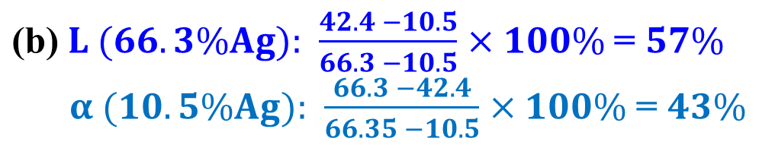
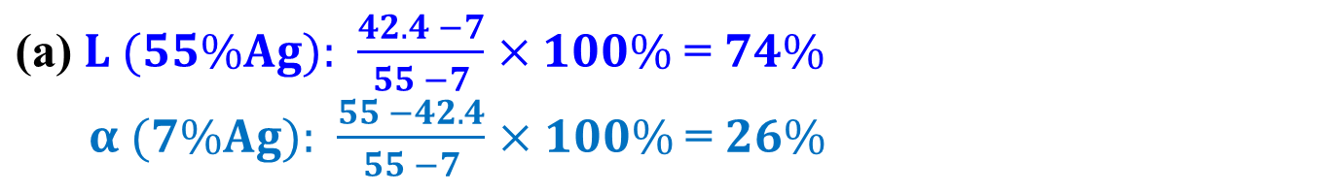
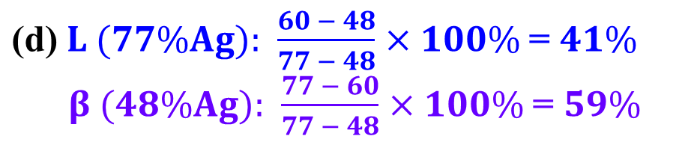
EP. 8.7 Make phase analyses at the following points in the Pt-Ag phase diagram. (a) 42.4% Ag, 1400 °C; (b) 42.4% Ag, 1187 °C; (c) 42.4% Ag, 1185 °C; (d) 60% Ag, 1150 °C.
$\text{(}\text{a}\text{)} L (55\%Ag): \frac{42.4 −7}{55 −7}×100\%$= $74\%$ $α (7\%Ag): \frac{55 −42.4}{55 −7}×100\%$= $26\%$
7
a
$\text{(}\text{b}\text{)} L (66.3\%Ag): \frac{42.4 −10.5}{66.3 −10.5}×100\%$= $57\%$ $α (10.5\%Ag): \frac{66.3 −42.4}{66.35 −10.5}×100\%$= $43\%$
b
10.5
c
d
77
$$\text{(}\text{c}\text{)} β (42.4\%Ag): 100\%$$
$\text{(}\text{d}\text{)} L (77\%Ag): \frac{60 − 48}{77 − 48}×100\%$= $41\%$ $β (48\%Ag): \frac{77 − 60}{77 − 48}×100\%$= $59\%$
28
28

Slide 29
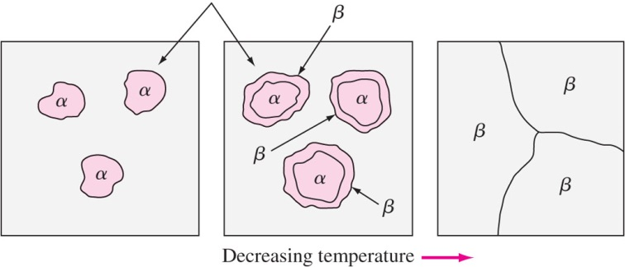
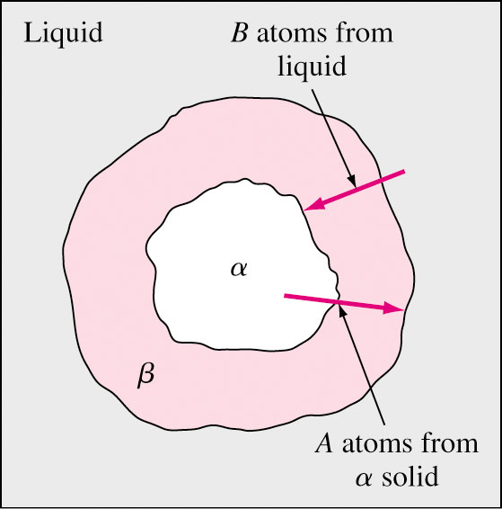
Peritectic Reaction Progress
Liquid
Surrounding or Encasement: During peritectic reaction, L + α → β , the beta phase created surrounds primary alpha.
Beta creates diffusion barrier resulting in coring.

Slide 30
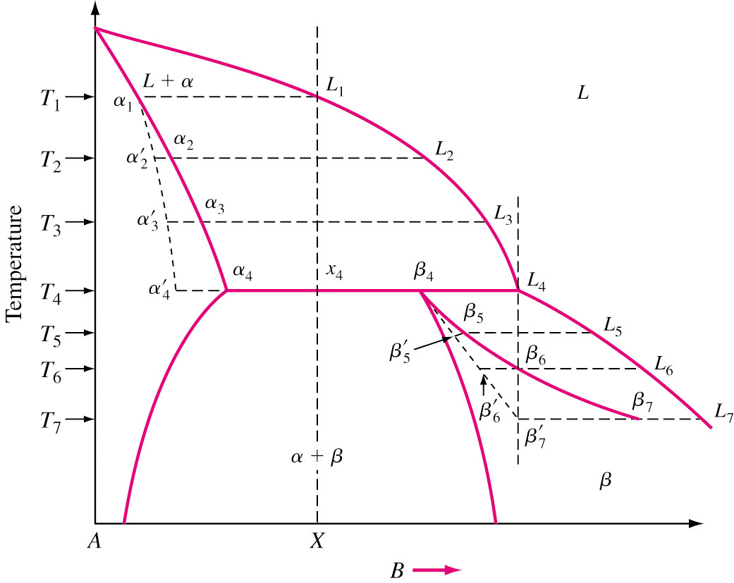
Rapid Solidification in Peritectic System
Nonequilibrium solidus: α₁ α’₂ α’₃ α’₄ β₄ β’₅ β’₆ β’₇

Slide 31
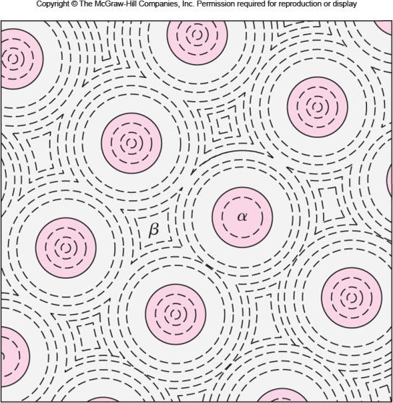
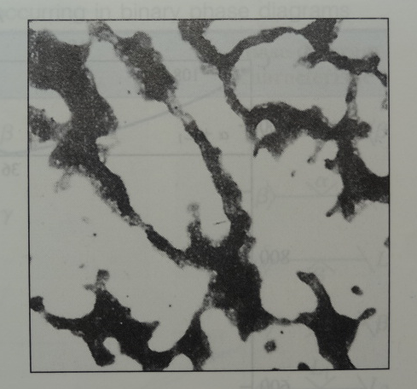
Peritectic Coring
Cored α
Cored β
β (Ag)
Cored α (Pt)
Cored β (Ag)
β
Fig. 8.22 Surrounding or encasement in a cast peritectic-type alloy.
Fig. 8.23 Cast 60Ag-40Pt hyperperitectic alloy.

Slide 32
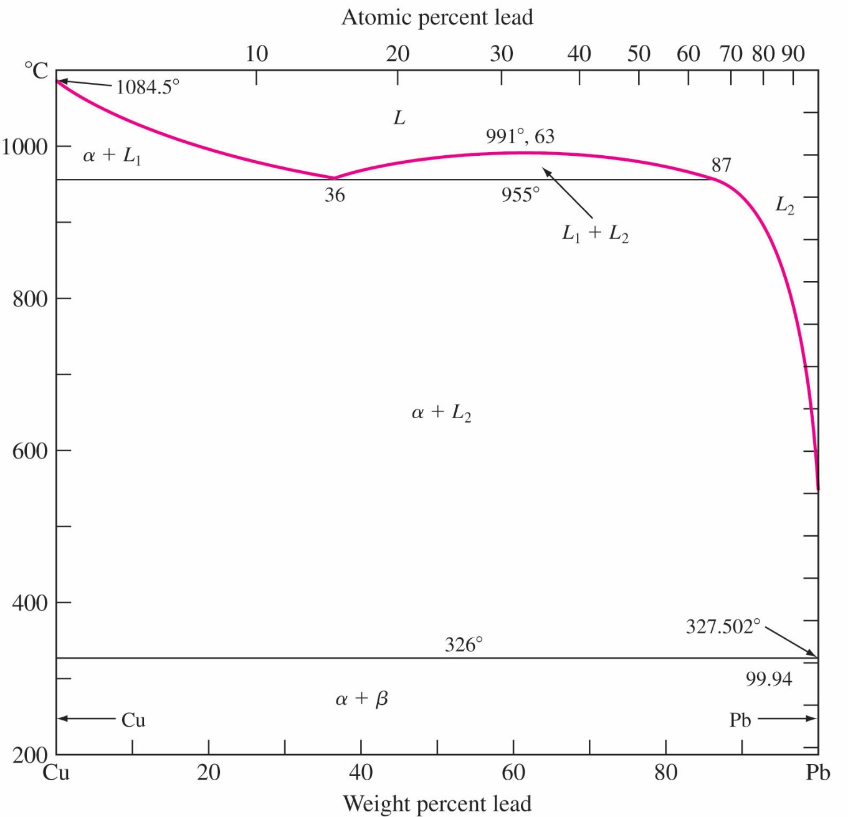
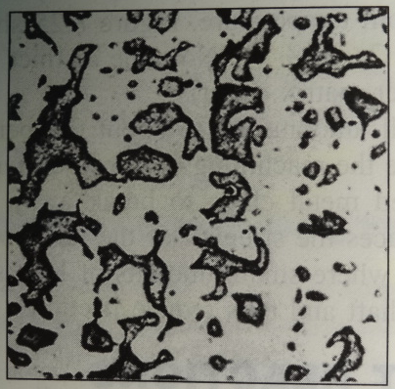
Binary Monotectic Systems 二元偏晶系
Monotectic Reaction: Liquid phase transforms into solid phase and another liquid.
955 °C, 36%Pb Monotectic 偏晶: L₁ (36Pb) → α (Cu) + L₂ (87Pb)
326 °C, 99.94%Pb Eutectic 共晶: L → α (Cu) + β (Pb)
Add 0.5%Pb to improve machinability.
β (Pb)
α
α
Cast Cu-36Pb alloy
32
Leaded alloys for bearing.

Slide 33
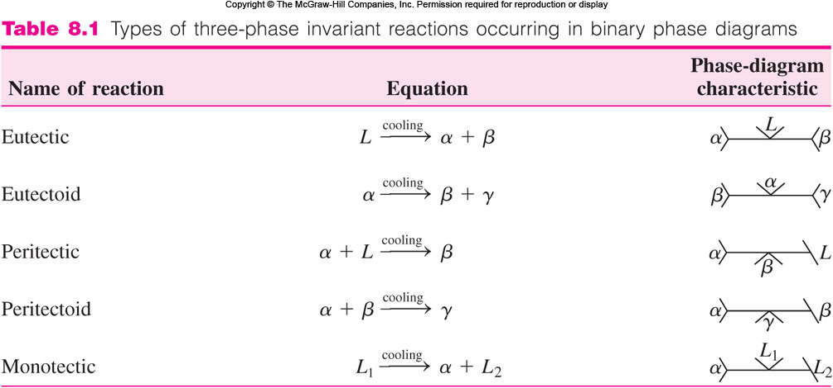
Three-phase Invariant Reaction
共晶
共析
包晶
包析
偏晶
The peritectic and peritectoid reactions are the inverse of the corresponding eutectic and eutectoid reactions.
The temperatures and compositions of these invariant reactions are fixed, i.e. F = 0.

Slide 34
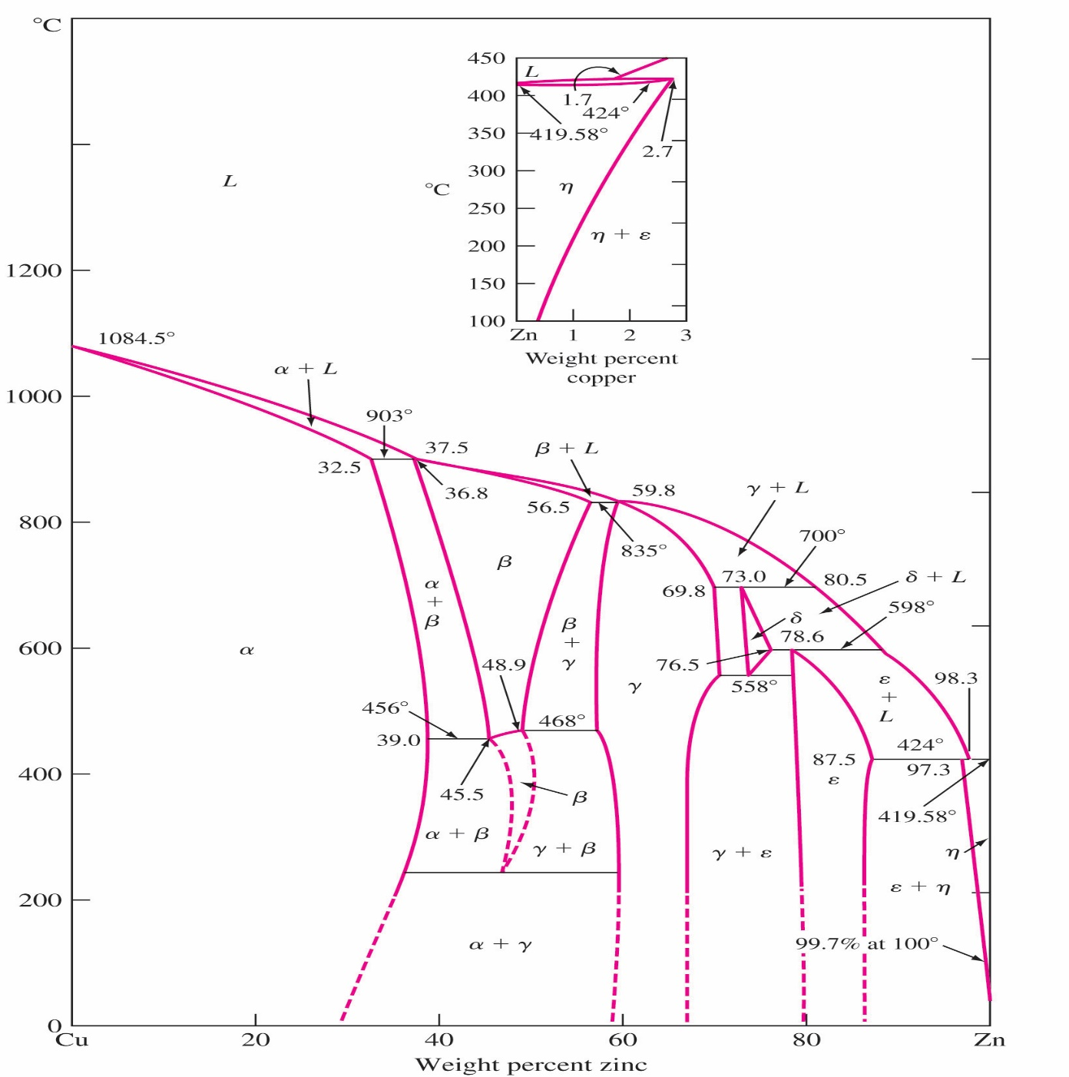
Intermediate Phases and Compounds
終端相
L + α → β L + β → γ L + γ → δ L + δ → ε L + ε → η
δ → γ + ε
Terminal phases: Phases occur at the end of phase diagrams.
Intermediate phases: Phases occur in a composition range inside phase diagram.
Examples: Cu-Zn diagram has both terminal and intermediate phases. Five invariant peritectic points and one eutectoid point.
中間相
β
δ
α
γ
ε
η
34
Figure 8.26

Slide 35
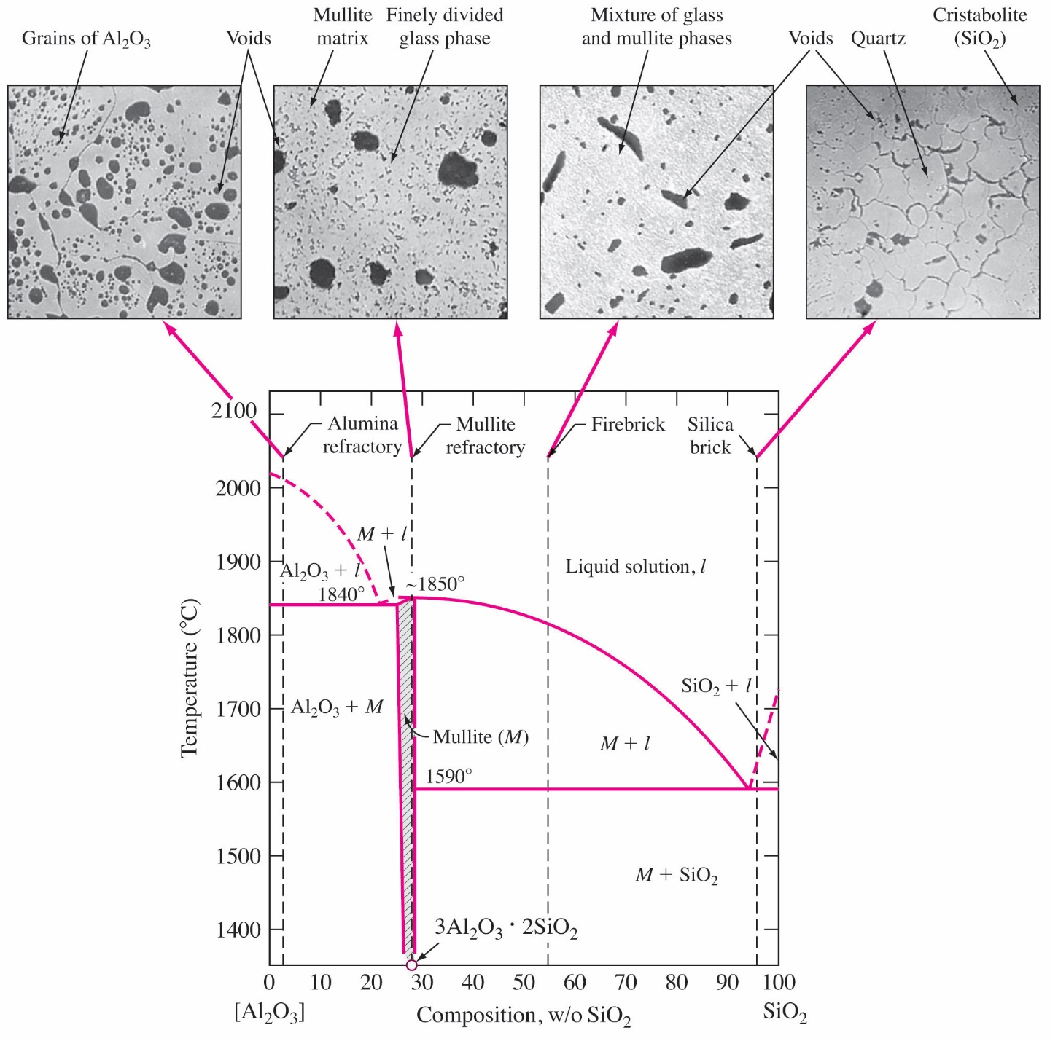
Intermediate Phases in Ceramics
Fig. 8.27 The phase diagram of Al₂O₃–SiO₂ system.
In Al₂O₃–SiO₂ system, an intermediate phase called Mullite is formed, which includes the compound 3Al₂O₃⋅2SiO₂.
Many refractories have Al₂O₃ and SiO₂ as their main components.
35

Slide 36
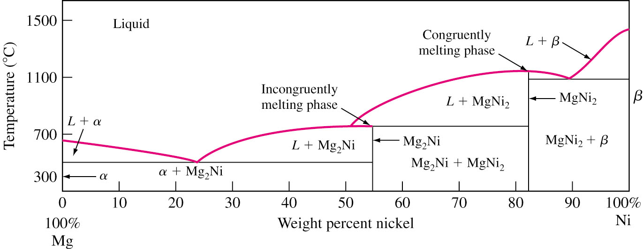
Intermediate Compounds
In some phase diagrams, intermediate compound are formed – Stoichiometric 量論比 or Non-Stoichiometric compound Metal systems: intermetallic compound or intermetallic.
Percent Ionic/Covalent bond depends on electronegativeness.
Example: Mg-Ni phase diagram contains
MgNi₂: Congruently melting compound 調和熔化化合物
Mg₂Ni : Incongruently melting compound 非調和熔化化合物

Slide 37
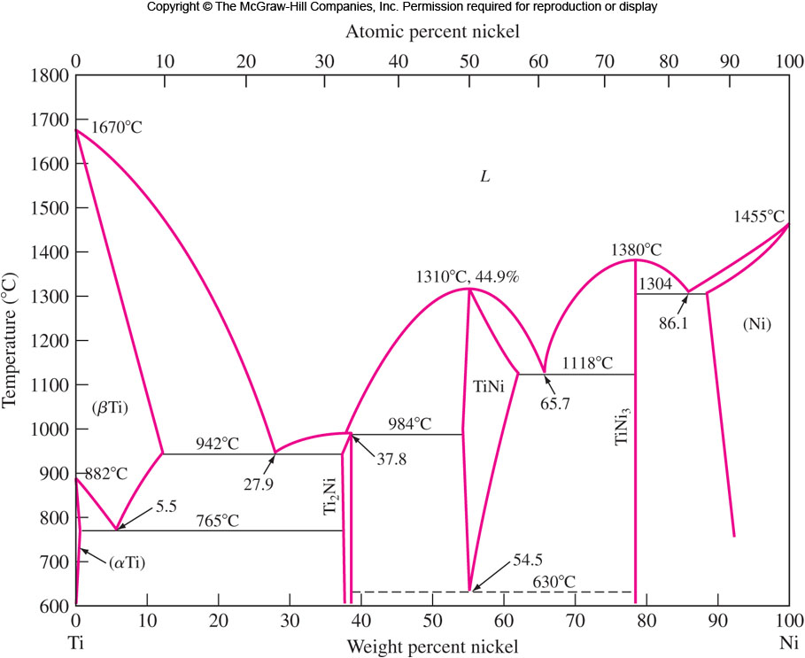
Ti-Ni Phase Diagram
終端相
Singular points: 1670 °C, 1310 °C, 1380 °C, 1455 °C
Congruent points: 1310 °C, 1380 °C
Red: Peritectic 1; Blue: Eutectoid 2; Green: Eutectic 3
L → TiNi₃
L → TiNi
f
86.1
e
c
65.7
b
37.8
5.5
27.9
a
54.5
d

Slide 38
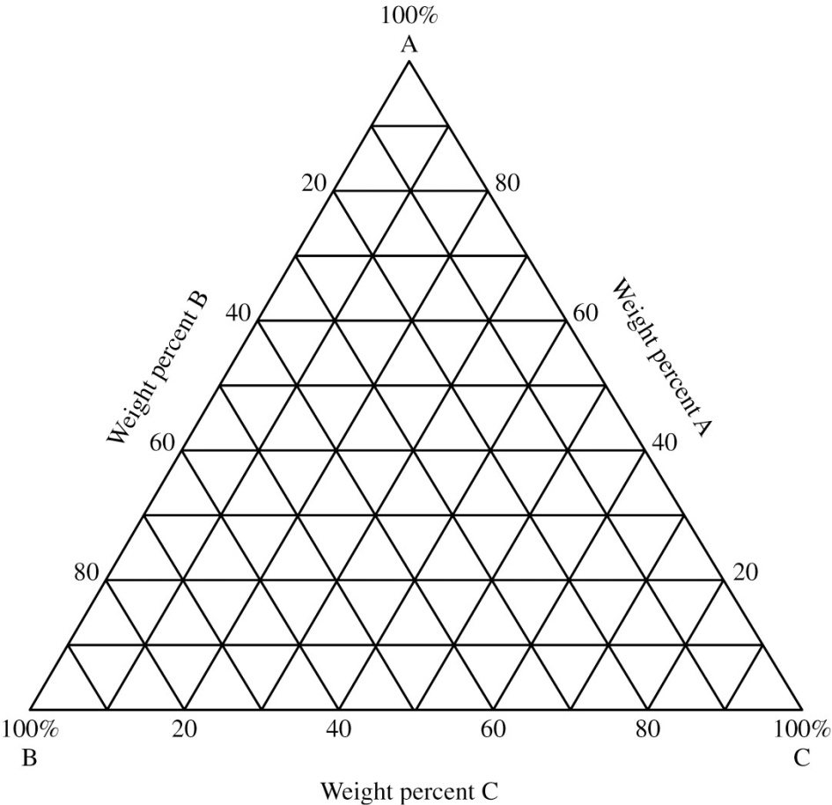
Ternary Phase Diagrams
Three components
Constructed by using a equilateral triangle as base.
60A20B20C
Pure components at each end of triangle.
Binary alloy composition represented on edges.
Temperature can be represented as uniform throughout the Whole Diagram → Isothermal section.
30A30B40C

Slide 39
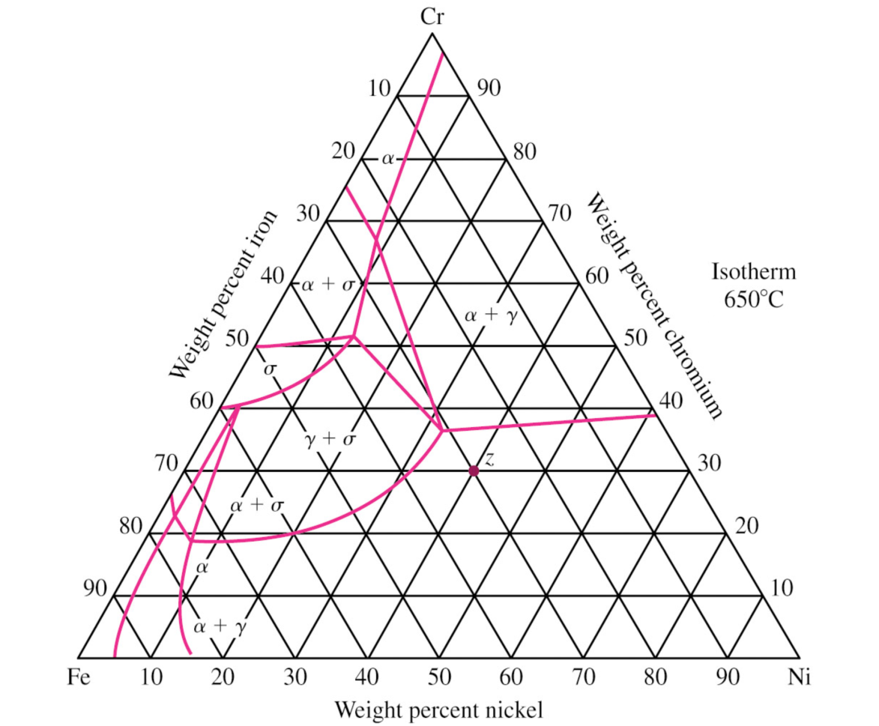
Ternary Phase Diagrams Isothermal section
γ

Slide 40
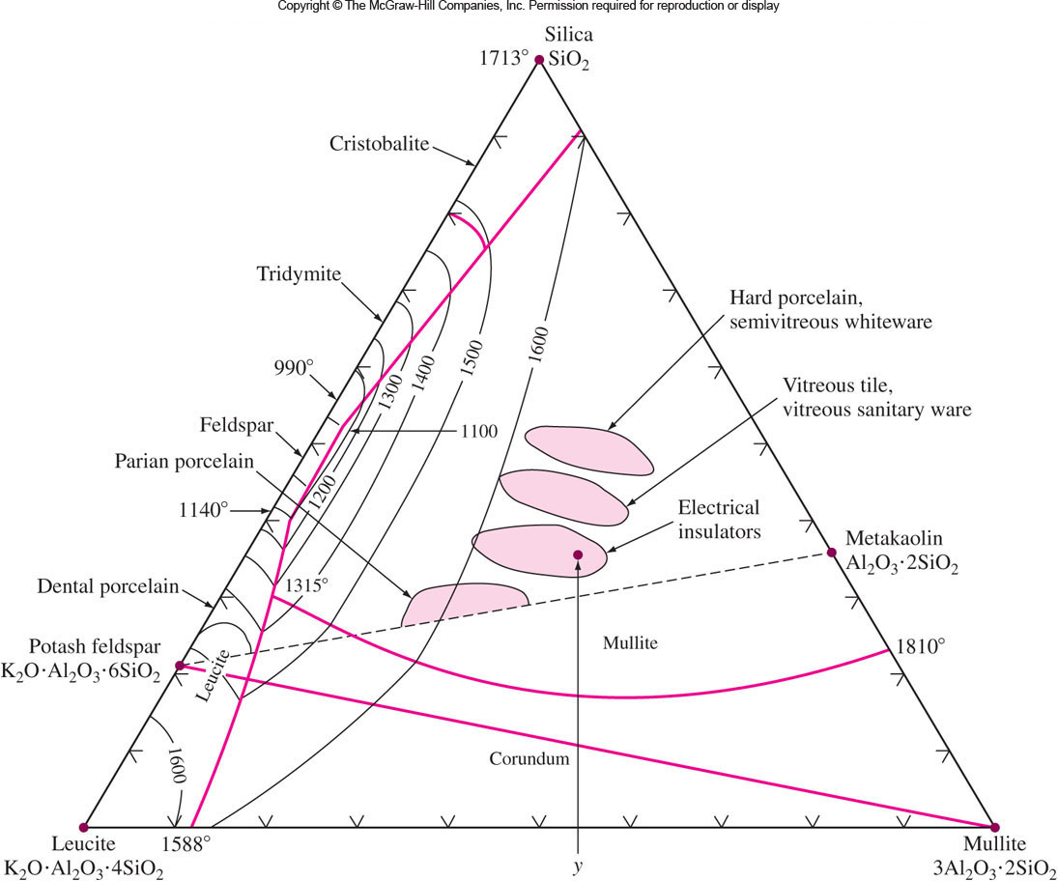
Silica-Leucite-Mullite Phase Diagram
矽氧
Temperature contour
白矽石
鱗石英
長石
白榴石
剛玉
莫來石

Slide 41
Iron-Chromium-Nickel Phase Diagram
Isothermal reaction at 650 °C for this system
Composition of any metal at any point on the phase diagram can be found by drawing perpendicular from pure metal corner to opposite side and calculating the % length of line at that point.
α + σ + γ
α + σ + γ
γ
18-8 Stainless Steel
41

Slide 42
Summary
Phase diagram: Constructed from cooling curves. Phases are equilibrium present at various Temperature and Composition.
Using level rule to calculate the wt% of each phase.
Liquidus, Solidus, Solvus, Terminal phases, Intermediate phases, Intermetallic Compound, Stoichiometric and Non-stoichiometric, Congruent and Incongruent melting compounds.
Invariant Reactions: Eutectic, Peritetic, Monotectic, Eutectoid, Peritectoid reactions.
Rapid cooling → Non-equilibrium solidus, Coring structure → Can be eliminated by homogenizing.
Ternary phase diagram: An equilateral triangle as a base with temperature on a vertical axis.

